Slide 1


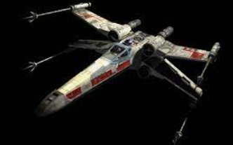
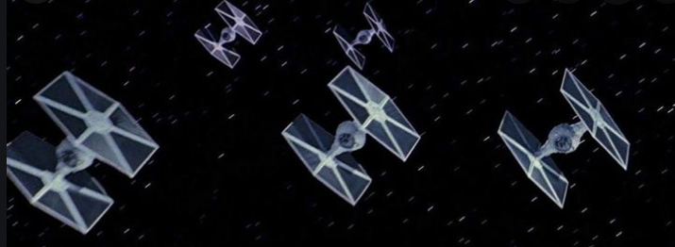
Controls
Left & Right arrow keys - move ship
Spacebar - fire missiles
Press any key to START the game

Slide 2

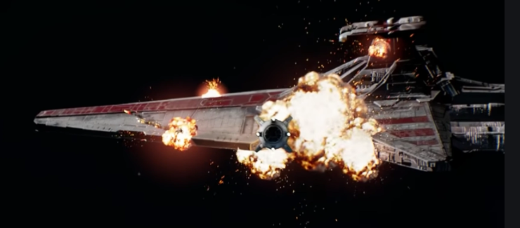
Press any key to RESTART the game
Close the window to EXIT

